Slide 1
工作展示 Works Collection
Ruby, 2021
Optimization, Simulations

Slide 2
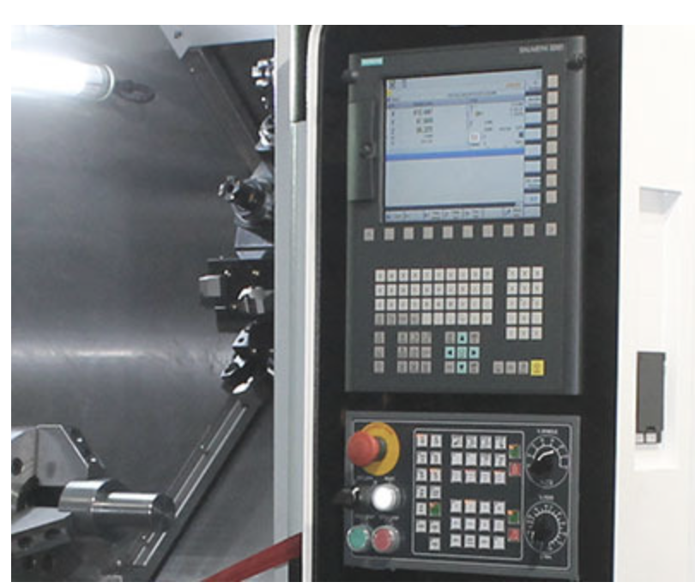
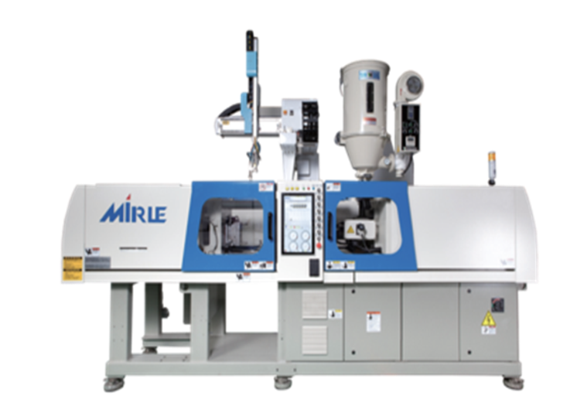
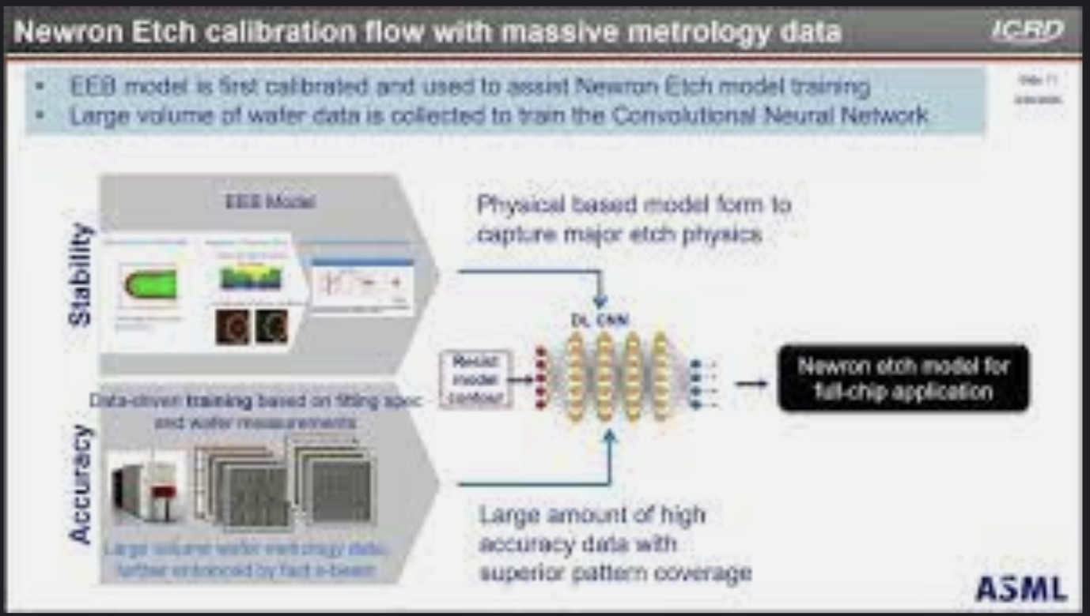
Work Experiences
Mirle (Jan. 2018 - Aug. 2019) Software Engineer
Matlab/Sim. experiment environment building
C controller code maintenance
ASML(Aug. 2019 - 2020) Senior Field Engineer
Model fitting (customer support)
CWB (2021) Senior Software Engineer
Megawin(2021) Layout and IT engineer

Slide 3
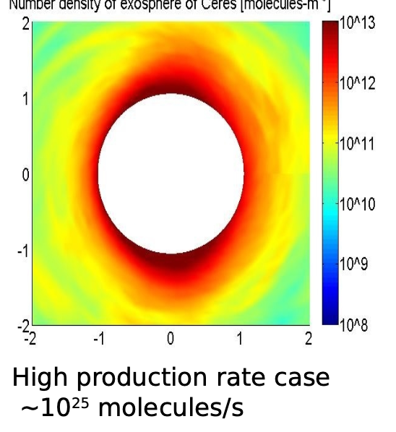
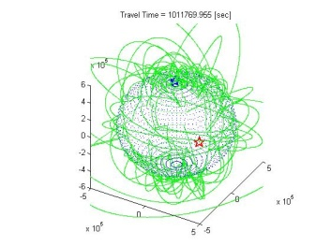
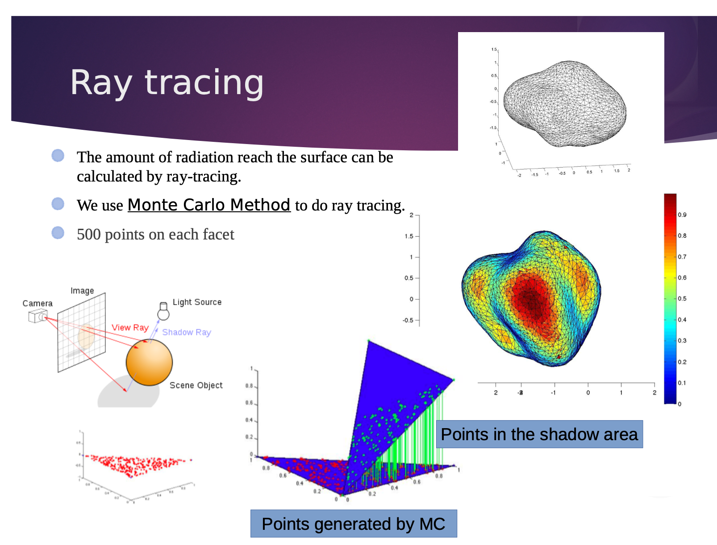
高空軌跡模擬＆溫度模擬
分子在高空彈道軌跡模擬圖
溫度模擬

Slide 4
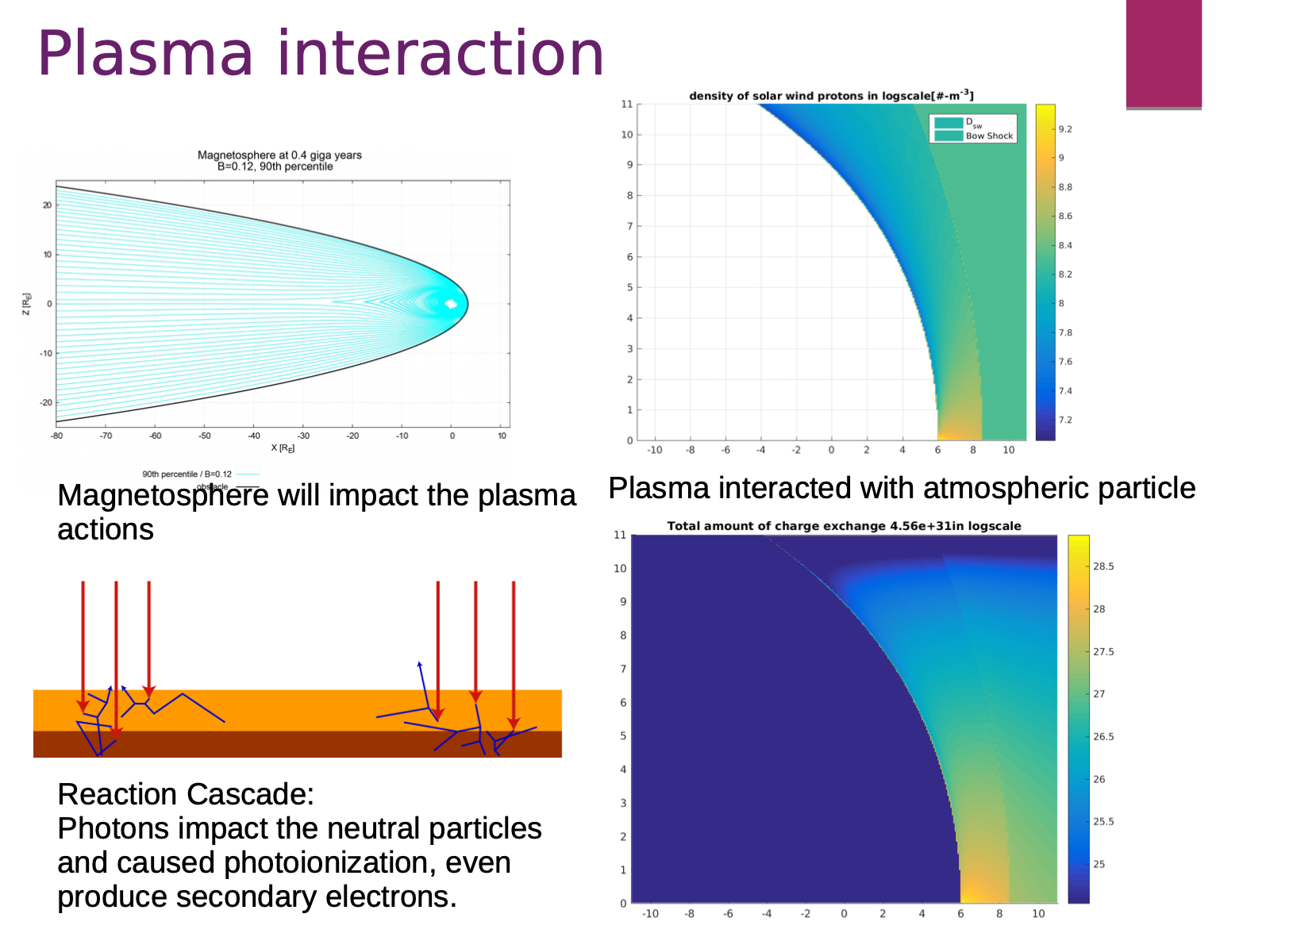
Plasma interaction

Slide 5
Analys excel data
Read excel data
Output in json format
Analysis and generate statistical figure in python

Slide 6
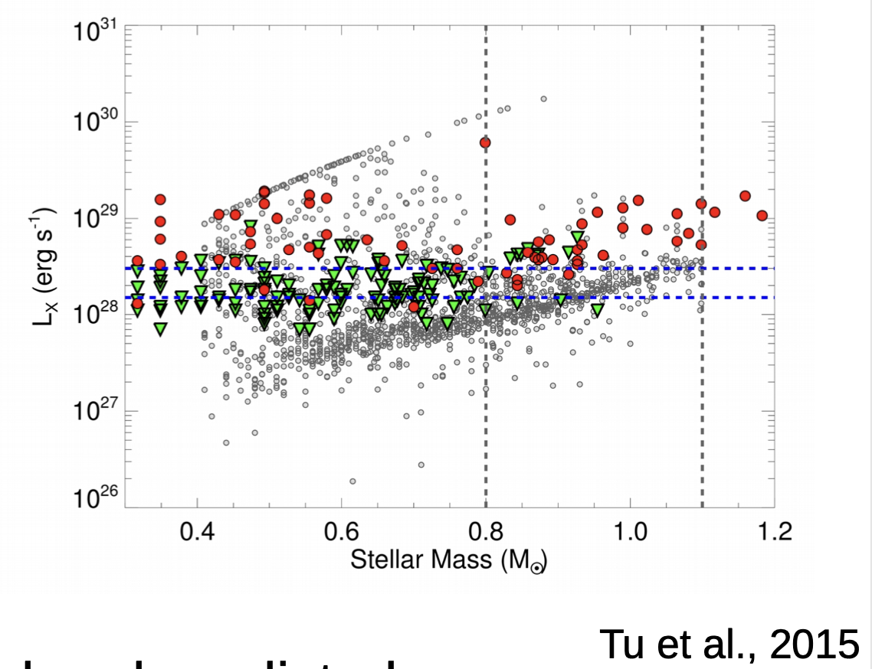
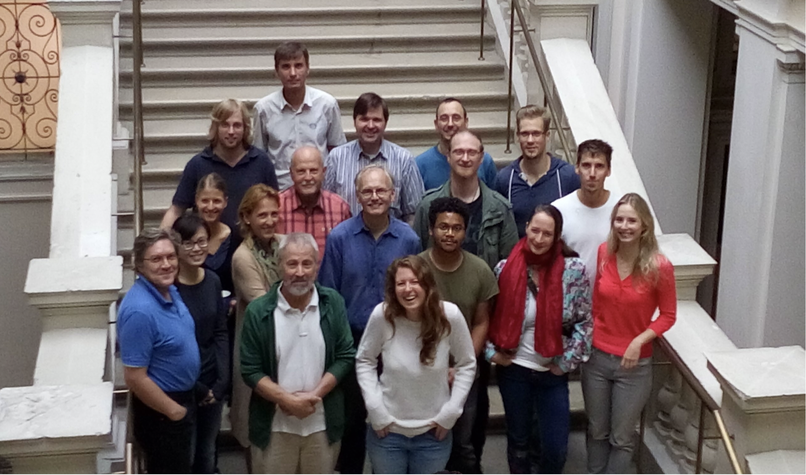
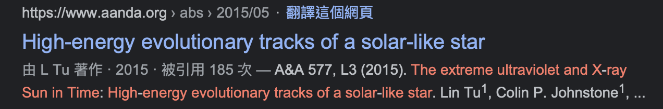
Data clean & Analysis
Automation flow of data analysis (by Matlab)
Gray dots are model data, red and green dots are experimental data

Slide 7
最佳化轉移函式
二階轉移函式用基因演算法找出最佳化參數
轉移函式的公式$1-exp(-\frac{tt}{x_{0}})*\frac{sinx_{2}t-x_{3}}{\sqrt{1-x_{1}^{2}}}$

Slide 8
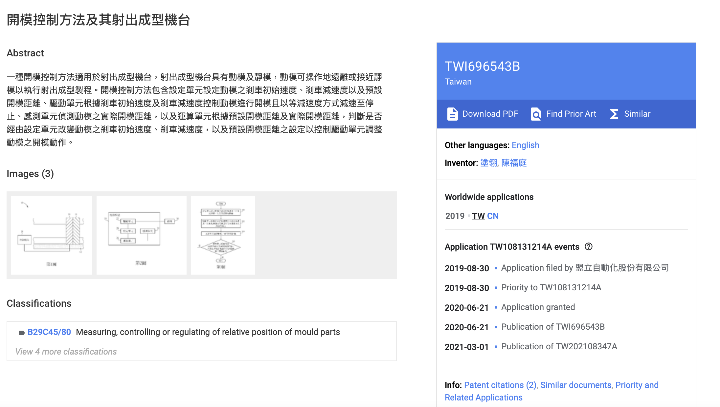
Patent

